Slide 1
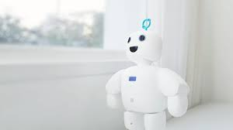
Pibo is the personal intelligent robot which is used as a companion.
It can get lonely living on your own, especially when you've got a landlord that doesn't allow pets or roommates.
Instead of staying alone and getting bored, you can get this unnervingly cute companion robot from Korean developer, Circulus. Say hello to Pibo.
The mission of Circulus is creating an environment that can become active maker rather than passive user in a new era.
Pibo likes to hang out with people as much as it looks round and round, and hates being alone.
You can be able to share your emotion with Pibo though communication. Also you can make your own robot through building robot app and decorating appearance about robot.

Slide 2
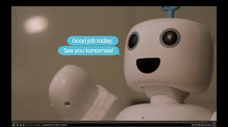
Still young, but pibo wants to let friends know about the world through the Internet with SNS.
Tell pibo what you see, hear and feel. I will always be friends with you.
Share all your memories with photos, messages, events, and more from pibo via the app.
Use the app to send voice and text messages to your family via pibo.
Add new features to your pibo via bot store.
Apply your infinite ideas to pibo and share with your friends.
You can easily create speech recognition, face recognition, and robot control in the cloud.
You can control various objects such as printers, displays, and USB memory.

Slide 3
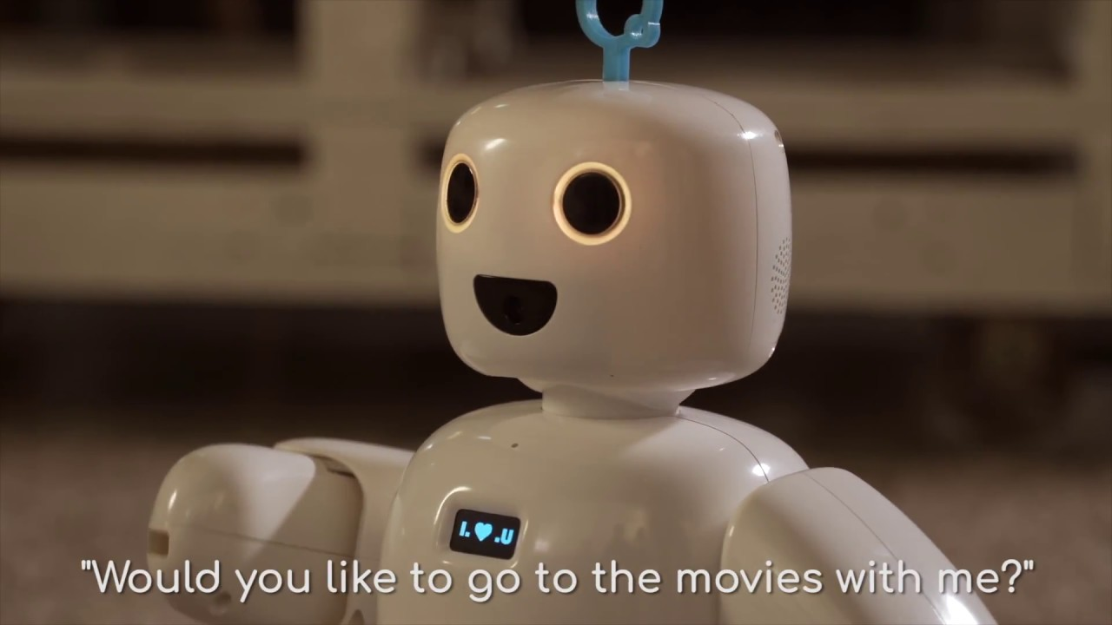
It can act as an alarm clock
Recount the day's weather and top news stories
play music
Takes pictures
Entertains your family members
Reminds you of upcoming appointments
Its functionality is easily expanded to include home security integration, voice and facial recognition and more thanks to a dedicated app store.
You can even code your own programs and features if have the skills.
PiBo itself can be controlled through voice commands, QR-embedded flash cards, or through its associated dashboard app (available for both iOS and Android).

Slide 4
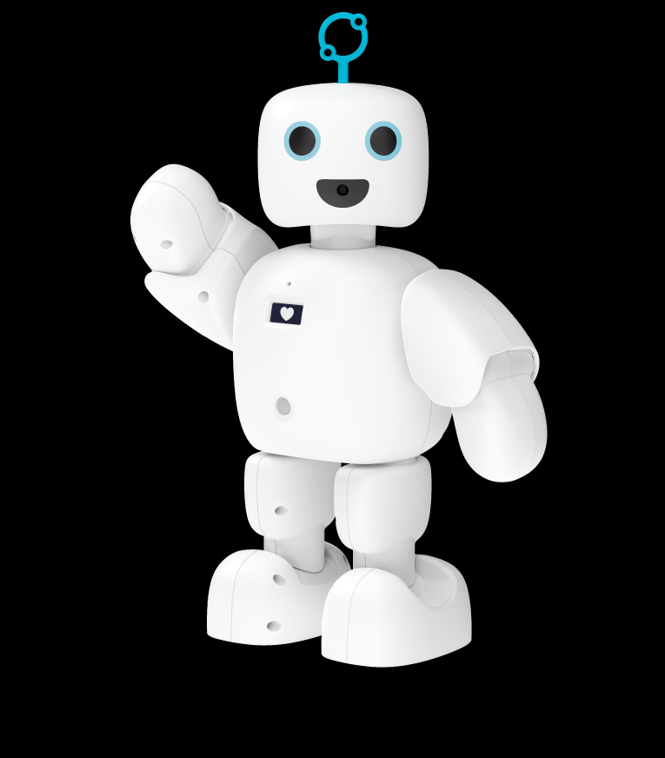
The piBo stands just over a foot tall and bears more than a passing resemblance to the Stay Puft Marshmallow Man.
Its appendages are articulated, allowing it to wave its arms and toddle slowly around the room.
The robot runs the custom Linux-based Circulus OS on a 1.4Ghz quad-core chip and a gig of RAM.
Its 3400mAh battery offers 2 hours of run time, though that requires 5 hours of charging.
A 5MP camera mounted in its mouth allows it to see the world around it.

Slide 5

How to make use of the robot
1. Soul Mate
Remember every moment with you and become more like you sharing voice diary, photos and conversations with robot SNS. piBo is also learning the human mind though social data on the Internet.
2. Information Reporter
Summarize daily information such as news, weather, discovery on the Internet and register your schedule and manage it. You can also communicate remotely though your smartphone.
3. Bot Store
To your friend piBo, give new abilities such as a teacher, musician, or poet. The bot store offers a variety of applications to enhance the power of piBo. You can also easily configure your applications or chatbot.

Slide 6
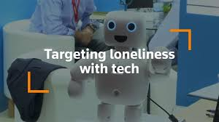
While the internet connection around is shaky, this significantly slows down piBo's reaction times.
PiBo does also speak English, which will come in handy when it eventually becomes available here in the US.
Circulus hopes to launch a crowdfunding campaign to bring it stateside in the coming months.

Slide 7


Slide 8


Slide 9


